Slide 1
Saving Radio Astronomy with (some) Python
Justin (Jay) Smallwood

Slide 2
Who am I?
2025 - 2029: PhD student @ Swinburne University
2018 - 2025: Equity trader & software engineer in finance
2011 - 2017: BCom (Economics) & MSci (Mathematics)
University of Melbourne

Slide 3
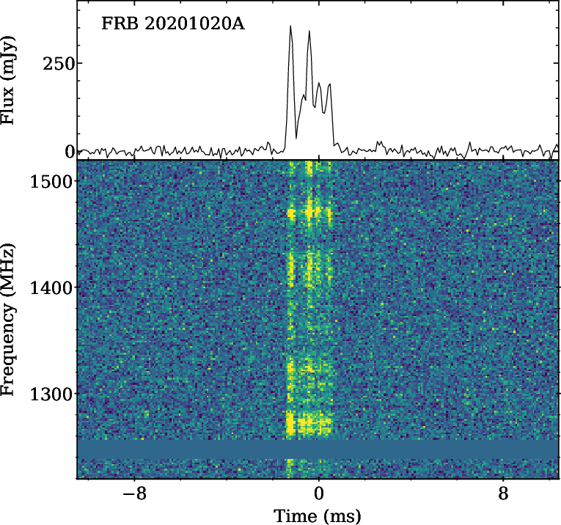
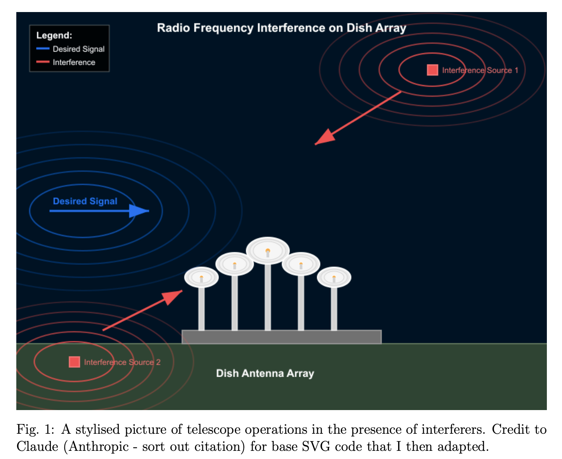
What’s the Problem?
Radio
Frequency
Interference

Slide 4
What’s the Problem?(Marazuela et al.)

Slide 5
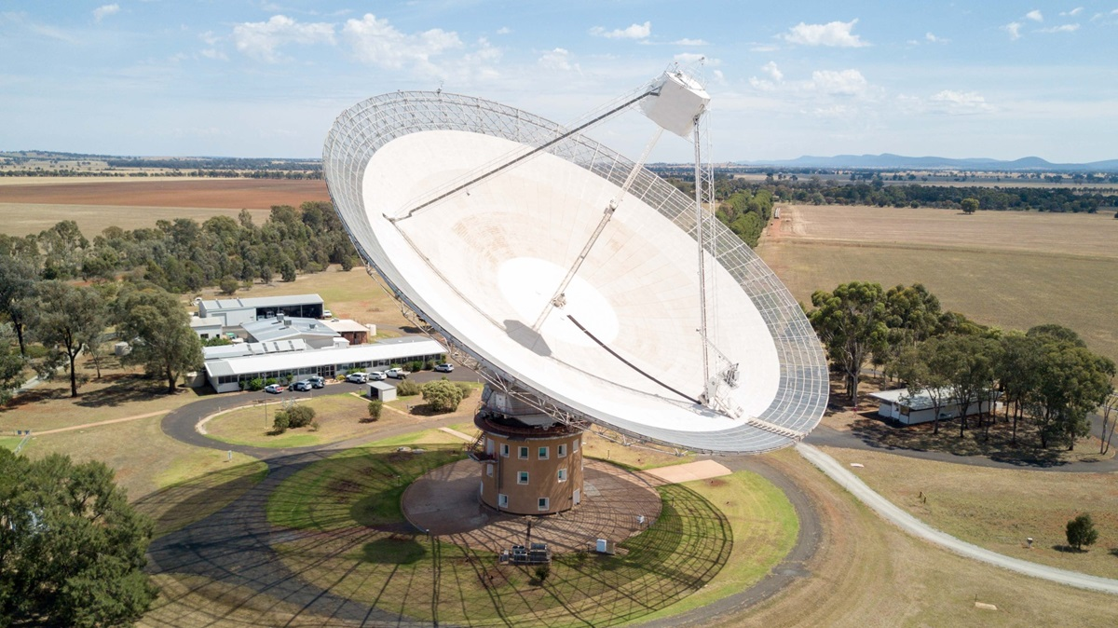
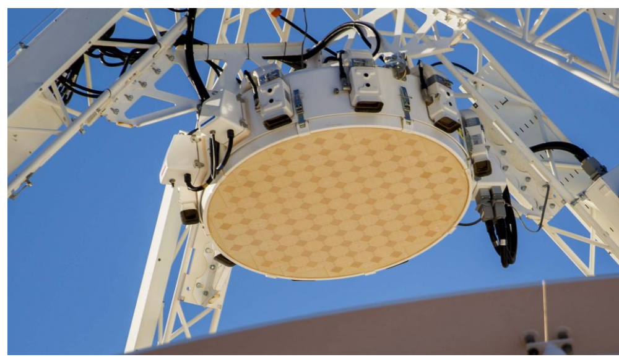
How We’re Going to Solve It!
PHASED
ARRAY
FEED

Slide 6
Phased Array Feeds & Spatial Filtering
Mathemagically filter out interference using Spatial Filtering.
Problem: Data velocity is huge! TB / sec!!!
Solution: High-performance C++ / CUDA code running at telescope.

Slide 7
How I’m Using Python…
Python Use #1:
Making small interactive applications to simulate & understand mathematical techniques of spatial filtering.
Streamlit to the rescue!
apps.jsmallwood.net/extraterrena

Slide 8
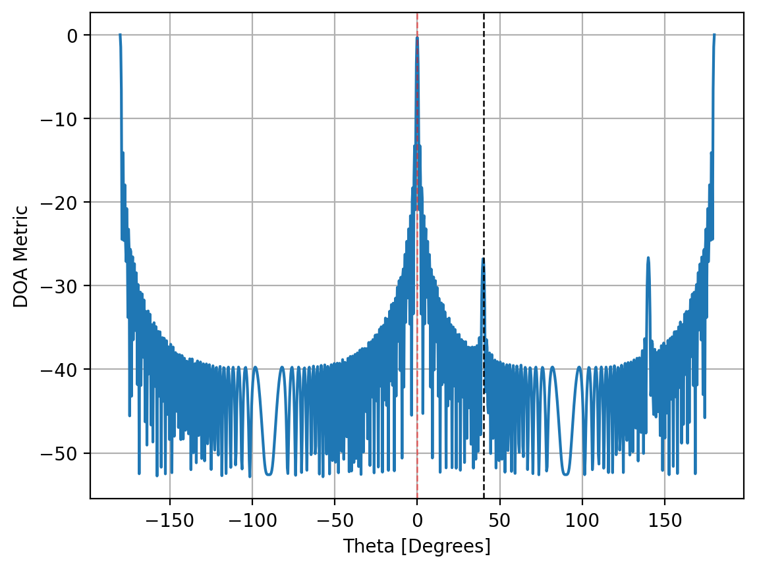
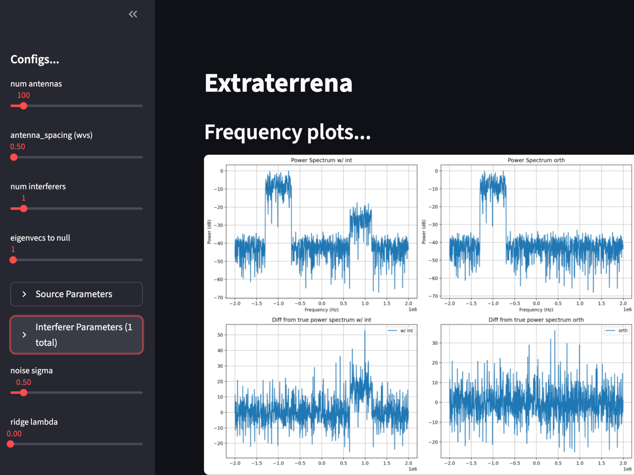
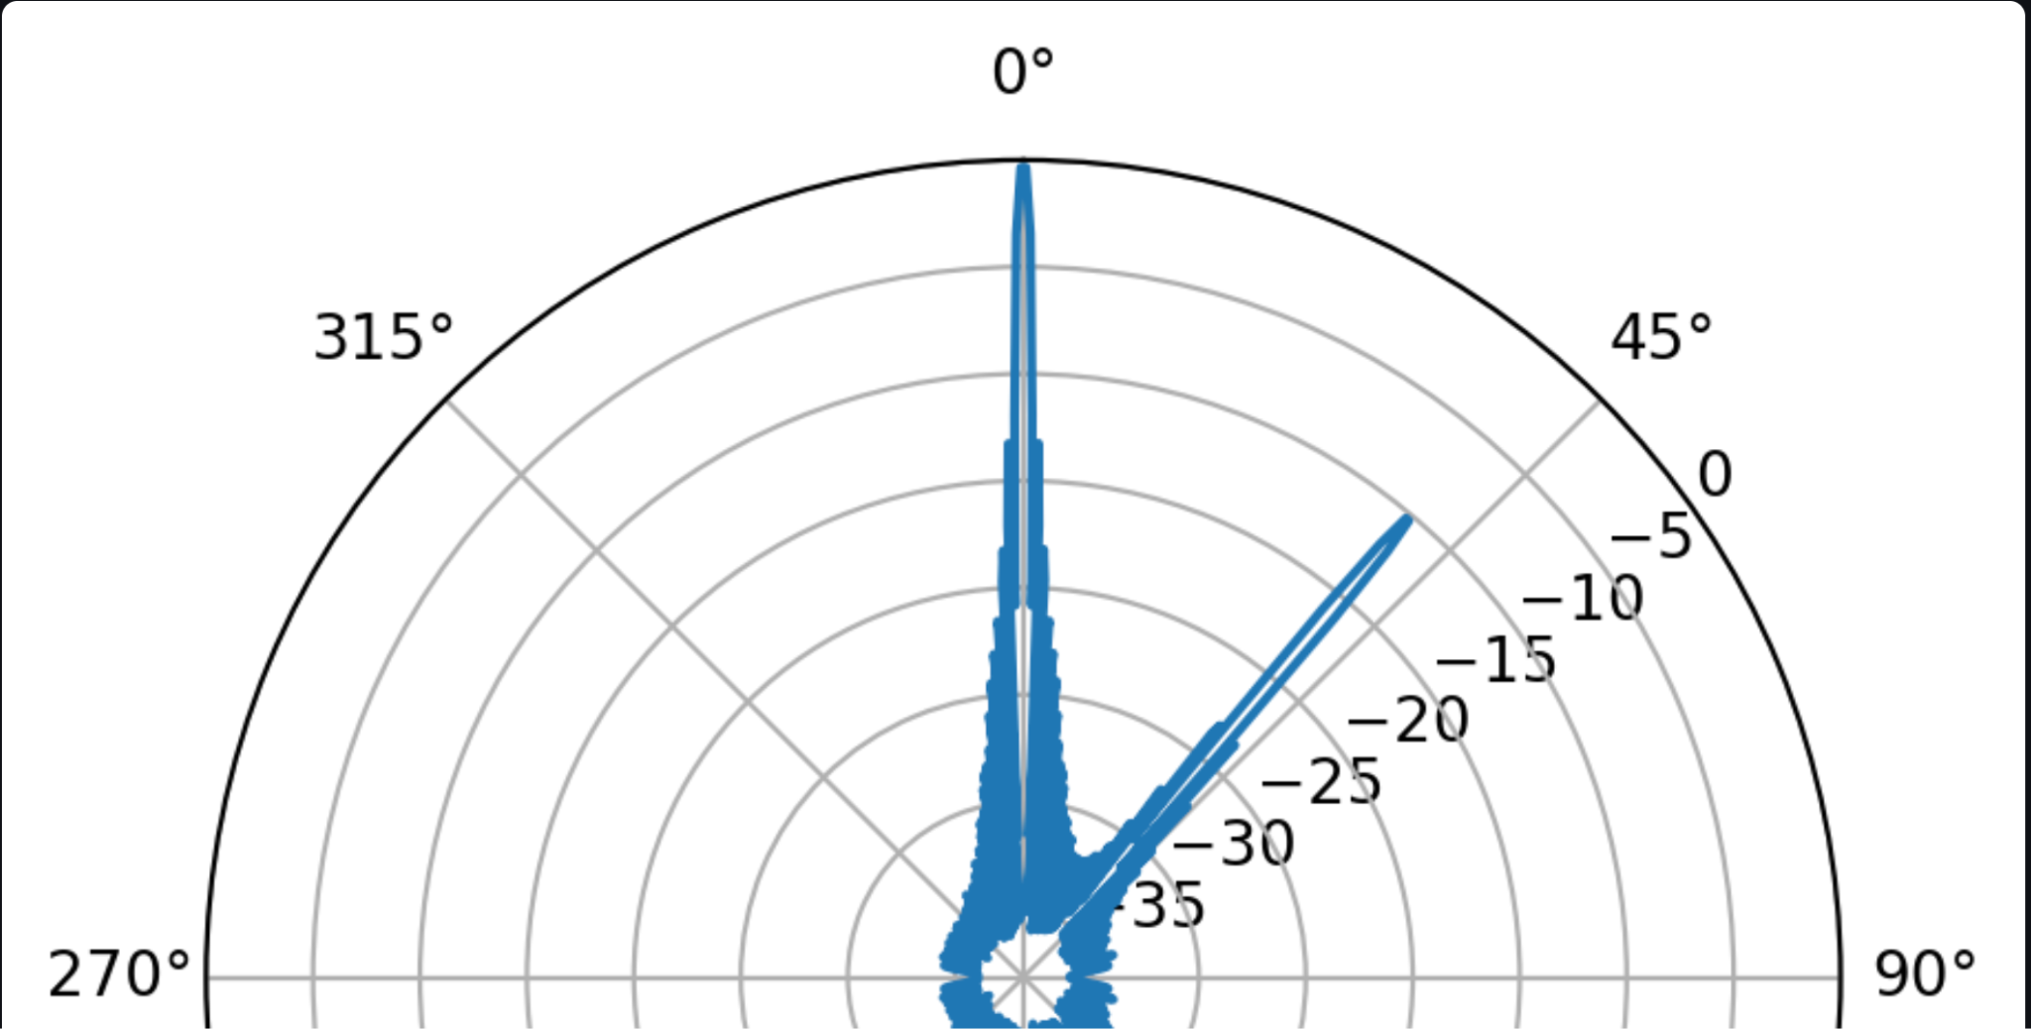
How I’m Using Python…

Slide 9
How I’m Using Python…
Python Use #2:
Use Python to shorten development feedback loops.
Prototyping C++ code.
Write Python in a C++ style and ensure the basic ideas work.
Then port to C++ - much easier!

Slide 10
Eventually…

Slide 11
Thank you!
Website & Apps: jsmallwood.net
GitHub: github.com/jdgsmallwood

